Slide 1

PROJECT REPORT
on
HOSTELIA: The Hostel Management System
Submitted in partial fulfillment of requirements for the award of
Bachelor of Computer Application
Submitted by:
Amarjoti Gogoi (CS22BCAGN009) Kekhav Sonowal (CS22BCAGN014) Gautam Paik (CS22BCAGN023) Under the supervision and Guidance of Miss. Priyanka Mazumder
Assistant Professor, The Assam Kaziranga University
Department of Information Technology
School of Computing Sciences
The Assam Kaziranga University, Jorhat, Assam
JORHAT-785006 :: ASSAM :: INDIA
[1]

Slide 2
CERTIFICATE
This is to certify that the project report entitled “HOSTELIA– The Hostel Management System”, submitted to the Department of Information Technology under the School of Computing Sciences (SCS), THE ASSAM KAZIRANGA UNIVERSITY, JORHAT,
ASSAM, in partial fulfillment for the completion of Semester – IV of the degree of Bachelor
of Computer Application, is a record of bona fide work carried out by Amarjoti Gogoi (CS22BCAGN009), Kekhav Sonowal (CS22BCAGN014) & Gautam Paik (CS22BCAGN023) under my supervision and guidance.
All help received by us from various sources have been duly acknowledged.
No part of this report has been submitted elsewhere for award of any other degree.
--------------------------------
-------------------------------
Dr. Karthik Kovuri
Miss. Priyanka Mazumder
Dean, SCS
Assistant Professor, SCS
The Assam Kaziranga University
The Assam Kaziranga University
[2]

Slide 3
ACKNOWLEDGEMENT
We would like to express our sincere gratitude to everyone who supported us throughout the development of our 3D renderer project. First and foremost, we extend our thanks to our project advisor, Miss. Priyanka Mazumder , for their invaluable guidance, feedback, and encouragement at every stage. Their invaluable feedback and insights were instrumental in shaping the final output.
We are grateful to our institution and the School of Computing Sciences for providing us with the resources needed to bring this project to life. We, the undersigned, declare that the work presented in this report is original and has not been submitted elsewhere for academic credit. We certify that we adhered to the highest standards of integrity and originality in completing this work.
[3]

Slide 4
DECLARATION
We declare that all the materials embodied in the project report entitled “HOSTELIA: The Hostel Management System” submitted to the School of Computing Sciences (SCS), The Assam Kaziranga University, Jorhat, Assam, by me as a 5th semester project in the partial fulfillment of Bachelor of Computer Application is original and no part of the report submitted to any other institution or organization for the award of any degree or diploma. I have adhered to all principles of academic honesty and integrity and have not misrepresented or fabricated or falsified any idea/data/fact from any other sources in my project report. For any violation of the above facts I shall remain solely responsible.
------------------------------- | ----------------------------- | ----------------------------
Amarjoti Gogoi | Kekhav Sonowal | Gautam Paik
SCS, 5th Sem | SCS, 5th Sem | SCS, 5th Sem
ID: CS22BCAGN009 | ID: CS22BCAGN014 | ID: CS22BCAGN023
[4]

Slide 5
CONTENTS
Acknowledgement
Declaration
Contents
List Of Figures
Abstract
Chapter 1: Introduction
Overview of the Project
Problem Definition
Problem Definition
Scope of the Project
Chapter 2: Literature Review
Literature Review: The Evolution of Hostel Management Systems
Paper-Based to Digital: The First Steps
The Digital Transition: Basic Software Solutions
Enterprise Systems: Over-Engineering the Solution
The Gap in Current Solutions
HOSTELIA: A Human-Centralize Approach
Looking Forward
Project Details
Choosing the Right Tools: The MERN Stack
Paper-Based to Digital: The First Steps
How It All Works Together
Core Features that make HOSTELIA special
Smart Room Allocation
Maintaining Check-In/Check-Out
Comprehensive Data Management
Built-in Error Prevention
Screenshots
Chapter 4: Methods/Approaches
Development Approach
Design and Features
Technical Details
Testing Details 10.Implementation
Overview of Implementation
Frontend Implementation
Backend Implementation
Database Implementation
11. Conclusion
Future Work
Bibliography
3
4
5
6
7
8
10
13
17
18
19
20
21
[5]

Slide 6
LIST OF FIGURES
Figure Name | Figure Number | Page No.
Registration and login forms | 1 | 16
Homepage/ Dashboard | 2 | 16
[6]

Slide 7
ABSTRACT
HOSTELIA: The Hostel Management System is software-based application designed to developed for managing hostel operations such as student registrations, student room allotment, attendance tracking, and complaints handling. The system emphasizes efficiency and accuracy, addressing common challenges faced by hostel administrators with a user- friendly interface to interact with the system. Future enhancements include integrating AI for predictive analytics, automated processes, and intelligent decision-making.
[7]

Slide 8
CHAPTER 1
INTRODUCTION
Introduction
Overview of the Project
HOSTELIA: The Hostel Management System is a software-based hostel management system developed using the MERN (MongoDB, Express.js, React.js, Node.js) stack. The project aims to modernize and streamline hostel operations by offering digital solutions for room allotment, student check-ins, and centralized data management. HOSTELIA addresses the inefficiencies and challenges of traditional systems, ensuring better operational efficiency, reduced errors, and enhanced user experiences. The system is designed with scalability and future AI integration in mind to keep up with evolving requirements.
Problem Definition
Traditional hostel management systems are fraught with several limitations that hinder operational efficiency:
Manual Data Handling: Prone to errors, leading to room conflicts, incorrect records, and poor tracking of payments.
Time-Consuming Processes: Tasks such as room allotments and report generation require significant manual effort.
Scalability Issues: Managing larger hostels or increasing student numbers is cumbersome with manual or spreadsheet-based systems.
Accessibility Limitations: Physical or siloed records are difficult to retrieve and update in real-time.
Lack of Centralization: Fragmented data systems make coordination between hostel staff and administrators challenging.
HOSTELIA aims to address these problems by providing an automated, centralized, and user- friendly solution that improves accuracy, saves time, and scales effortlessly.
6.3 Objective of HOSTELIA
The primary objective of HOSTELIA is to create an innovative, user-friendly software application that simplifies and automates hostel operations. The system is designed to:
[8]

Slide 9
1. Streamline Room Allotment: Automate room assignments based on predefined rules (e.g., room type, gender, availability).
2.
Track Check-Ins and Check-Outs: Maintain a real-time log of student movements to improve security and convenience.
Centralize Data Management: Store student profiles, room details, and financial records in a secure and accessible database.
Reduce Errors: Implement validation mechanisms to minimize manual errors in operations.
Enhance User Experience: Offer a seamless interface for both hostel administrators and students, accessible from web and mobile platforms.
HOSTELIA’s objective is not only to modernize hostel management but also to lay the groundwork for future advancements, such as AI-powered decision-making, predictive analytics, and intelligent chatbots.
Scope of the Project
The scope of HOSTELIA extends to all aspects of hostel management, targeting the following primary users:
Hostel Administrators: Provide tools for room management, fee collection, report generation, and operational oversight.
Students: Enable an intuitive platform to view room details, make requests, and track fee payments.
Integration Potential: Future AI integration can bring features like predictive maintenance for hostel facilities, automated responses to student queries, and optimized resource allocation.
[9]

Slide 10
CHAPTER 2
LITERATURE REVIEW
7.1 Literature Review: The Evolution of Hostel Management Systems
In today's fast-paced educational environment, hostel administrators face the daily challenge of managing hundreds of students' living arrangements while ensuring their comfort and safety. Our review reveals how existing systems have attempted to address these challenges, and where they've fallen short of meeting the real needs of students and staff.
Paper-Based to Digital: The First Steps
Many hostels still rely on traditional methods - paper registers, filing cabinets, and basic spreadsheets. While familiar, these methods often create real frustrations.
These manual systems, while simple to implement, create daily challenges:
Students waiting in long queues during check-in periods.
Staff spending evenings reconciling paper records.
Constant worry about losing important documents.
Delayed responses to student and parent inquiries.
The Digital Transition: Basic Software Solutions
As hostels began digitalizing, many adopted simple software solutions. While these represented progress, they brought their own set of challenges:
A hostel warden at a technical college notes: "Our current software helps with basic room allocation, but when students want to change rooms or report maintenance issues, we still resort to paper forms because the system can't handle these requests."
Common limitations include:
Rigid interfaces that frustrate both staff and students.
Security concerns when handling sensitive data.
Systems that can't grow with increasing student numbers.
Lack of features for modern communication needs.

Slide 11
Enterprise Systems: Over-Engineering the Solution
Some institutions invested in comprehensive ERP systems, hoping to solve all their management challenges at once. However, as one hostel director puts it: "We paid for an expensive system that does everything except what we actually need. It's like buying a luxury car just to drive to the corner store."
These systems often present:
Prohibitive costs for smaller institutions.
Overwhelming complexity for daily tasks.
Features that go unused but can't be removed.
High training requirements for new staff.
The Gap in Current Solutions
Today's hostel managers need systems that understand their unique challenges:
Parents expect instant updates about their children's welfare.
Students want modern, app-based ways to interact with hostel services.
Administrators need quick access to accurate information.
Institutions require secure, efficient ways to manage operations.
7.6 HOSTELIA: A Human-Centralize Approach
HOSTELIA was developed after extensive interviews with hostel staff, students, and parents. It addresses real needs with practical solutions:
Putting People First
Simple, intuitive interfaces that respect users' time.
Mobile-first design that matches how students actually communicate.
Clear, instant notifications for important updates.

Slide 12
Growing with Needs
Scalable architecture that grows with student numbers.
Regular updates based on user feedback.
Future-ready features like AI assistance and predictive maintenance.
7.7 Looking Forward
HOSTELIA represents more than just another management system - it's a platform designed to enhance the hostel living experience for everyone involved. By focusing on real human needs rather than just technical capabilities, it aims to transform how hostels operate in the digital age.
The system's architecture supports future innovations while maintaining simplicity and usability, ensuring that technology serves people, not the other way around.

Slide 13
CHAPTER 3
PROJECT DETAILS
Building HOSTELIA: Our Technical Foundation
Choosing the Right Tools: The MERN Stack
In creating HOSTELIA, we wanted to build something that wasn't just powerful, but also flexible enough to grow with our users' needs. That's why we chose the MERN stack – a modern collection of technologies that work together seamlessly to create a robust hostel management system.
Our Technology Choices Explained
MongoDB: Think of MongoDB as HOSTELIA's digital filing cabinet, but infinitely more powerful. Unlike traditional databases that are rigid in structure, MongoDB adapts to our needs. This means we can easily store everything from student profiles to room assignments without being constrained by fixed formats. When we need to add new features or modify existing ones, MongoDB's flexibility makes these changes smooth and efficient.
Express.js: Express.js serves as our system's traffic controller. It efficiently directs
data between our users and the database, handling everything from student check-ins to room allocation requests. Its lightweight nature means faster response times for our users, while its robust feature set helps us maintain clean, organized code.
React.js: We chose React.js to build HOSTELIA's user interface because we believe
hostel management shouldn't feel complicated. React.js helps us create an interface that's not just beautiful but also intuitive. Whether it's a student checking their room assignment or an administrator managing multiple hostels, the experience remains smooth and responsive.
Node.js: Node.js is like HOSTELIA's engine room. It handles all our backend
operations efficiently, ensuring that whether we have 10 users or 10,000, the system remains responsive and reliable.

Slide 14
How It All Works Together
HOSTELIA's architecture is designed like a well-organized team, where each component has its specific role but works in harmony with others. Here's how information flows through our system:
The Frontend:
Students and administrators interact with HOSTELIA through user-friendly interfaces.
Each user sees a personalized dashboard based on their role.
Real-time updates keep everyone informed of important changes.
The Backend:
Processes all requests securely.
Implements payment tracking rules and logic.
Ensures data integrity and system security.
The Database:
Safely stores all information.
Enables quick retrieval of data when needed.
Maintains relationships between different types of information.
Core Features that make HOSTELIA special
Smart Room Allocation
Our room allocation system goes beyond simple assignment. It considers factors like:
Student preferences and compatibility.
Room availability in real-time.
Special requirements or restrictions.
Administrative override capabilities for special cases.

Slide 15
Maintaining Check-In/Check-Out:
We've simplified the movement tracking process to:
Record entries and exits efficiently.
Alert administrators about unusual patterns.
Provide students with their movement history.
Ensure campus security and student safety.
Comprehensive Data Management
HOSTELIA keeps everything organized and accessible:
Complete student profiles with all necessary details.
Automated fee tracking and payment reminders.
Structured complaint management system.
Easy report generation for administrative needs.
Built-in Error Prevention
We've implemented multiple safeguards to ensure accuracy:
Smart validation checks for all data entry.
Automated alerts for unusual patterns.
Role-based access control for security.
Regular data consistency checks.
By combining these elements, HOSTELIA creates a user-friendly system that transforms hostel management from a complex challenge into a streamlined process.

Slide 16
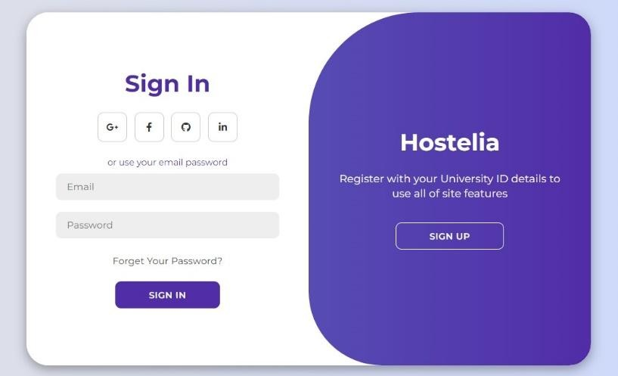
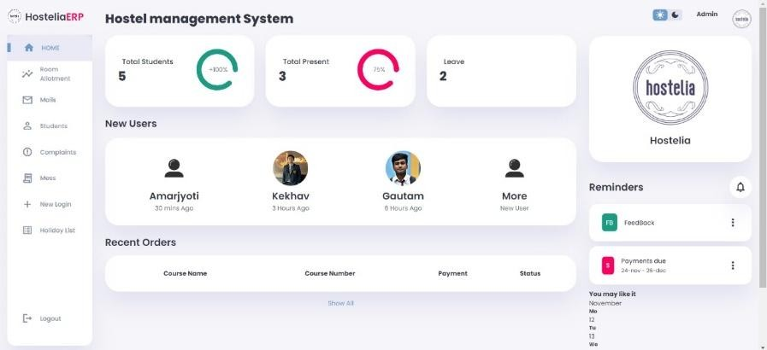
8.9 SCREENSHOTS
Fig 1: Registration and login forms
Fig 2: Homepage/ Dashboard

Slide 17
CHAPTER 4
METHODS / APPROACHES
Development Approach
The development process for HOSTELIA focused on gradually building and improving the system by:
Gathering requirements from hostel administrators and students to understand their needs.
Designing a user-friendly interface and a clear structure for managing operations.
Developing features like room allotment, check-ins, and data management using modern web technologies.
Testing each part of the system thoroughly to ensure it works correctly and is free from errors.
Design and Features
The system is divided into sections for specific tasks like room assignments, tracking student movements, and managing records.
The interface is designed to work smoothly on both computers and smartphones.
Technical Details
The user interface is built to be interactive and responsive.
The system processes requests quickly and manages the data effectively.
A central database securely stores all student, room, and transaction records.
Real-time updates show room availability and send alerts for important events.
9.4 Testing Details
Each feature is tested individually and as part of the whole system to ensure reliability.
Feedback from sample users helps refine the system.

Slide 18
CHAPTER 5
IMPLEMENTATION
10.1 Overview of Implementation
The implementation phase focuses on turning the design into a functional system by coding and integrating all modules of HOSTELIA. The MERN (MongoDB, Express.js, React.js, Node.js) stack was used for development, ensuring a scalable and efficient solution. The implementation process involves frontend development for user interaction, backend development for business logic, and database integration for secure data handling.
Frontend Implementation
Our front-end development focused on creating an interface that feels natural and responsive. Key achievements include:
Intuitive dashboards that adapt to different screen sizes.
Smart forms that make registration and room booking a breeze.
Real-time updates so users always see the latest information.
Seamless navigation between different features.
Backend Implementation
The backend was built using Node.js and Express.js to handle server-side operations and provide RESTful APIs.
Fast and reliable processing of student requests.
Bank-grade security to protect user data.
Smart systems that prevent unauthorized access.
Careful error handling to help users when things go wrong.
Database Implementation
The database layer was implemented using MongoDB, a NoSQL database suitable for handling structured and unstructured data.
Flexible storage that adapts to changing needs.
Lightning-fast access to information.
Automatic backups to keep data safe.

Slide 19
CHAPTER 6
CONCLUSION
The development of HOSTELIA, a modern hostel management system, addresses the limitations of traditional manual processes by providing an efficient, automated, and user- friendly solution. Built using the MERN stack, HOSTELIA managing critical operations such as room allotments, check-ins, data management, and complaint handling. The system significantly reduces human errors, saves time, and enhances the overall user experience for both administrators and students.
HOSTELIA stands out with its modular design and real-time data updates. The integration of AI in future iterations will further elevate the platform, enabling intelligent features such as predictive room allocation, automated complaint resolution, and personalized notifications.
Through this project, key objectives of digital transformation in hostel management have to be achieve, laying the foundation for scalability and innovation. HOSTELIA represents a step forward in leveraging technology to address practical challenges, demonstrating the potential for further enhancement and adoption across institutions.

Slide 20
CHAPTER 7
FUTURE WORK
Implementing Artificial Intelligence (AI)
AI integration will significantly enhance HOSTELIA’s capabilities, offering intelligent, data- driven features. Key areas of focus include:
Predictive Analytics: Building AI models to predict room preferences and fee payment trends based on historical data.
Smart Notifications: Developing an AI-powered notification system that sends personalized reminders and alerts based on user activity.
Feedback Analysis: Using sentiment analysis to automatically evaluate student feedback and suggest improvements for hostel services.

Slide 21
BIBLIOGRAPHY
Acharya, Kamal. “Hostel Management System.” SSRN Electronic Journal, January 2024. DOI: 10.2139/ssrn.4820829. Tribhuvan University.
Acharya, Kamal. “ATTENDANCE MANAGEMENT SYSTEM.” International
Research Journal of Modernization in Engineering Technology and Science (2023): n. pag.
GeeksforGeeks. How to Build Hostel Management System using Node.js. Retrieved
from https://www.geeksforgeeks.org/how-to-build-hostel-management- system-using-node-js/?ref=gcse_ind.
W3Schools. W3Schools Online Web Tutorials. Retrieved from https://www.w3schools.com.

